Slide 1



An Introduction to eXp Realty
United States Presentation

Slide 2





What We Will Cover
Who We Are
Our Business Model
Compensation
Cloud-based
Community
Join the team that’s breaking down boundaries

Slide 3

Founder
Glenn Sanford had important roles at internet startups before launching a real estate career in 2002.
In his fourth year in real estate with a major national franchisor, his team closed more than
$60 million in real estate by connecting with consumers online.
Glenn believed that agents and brokers do the heavy lifting in real estate and deserve the beneﬁts of being a shareholder and income based on their contributions.
In 2009, Glenn founded the ﬁrst cloud-based brokerage — eXp Realty.

Slide 4
Who We Are
How We Made It to Today

Slide 5
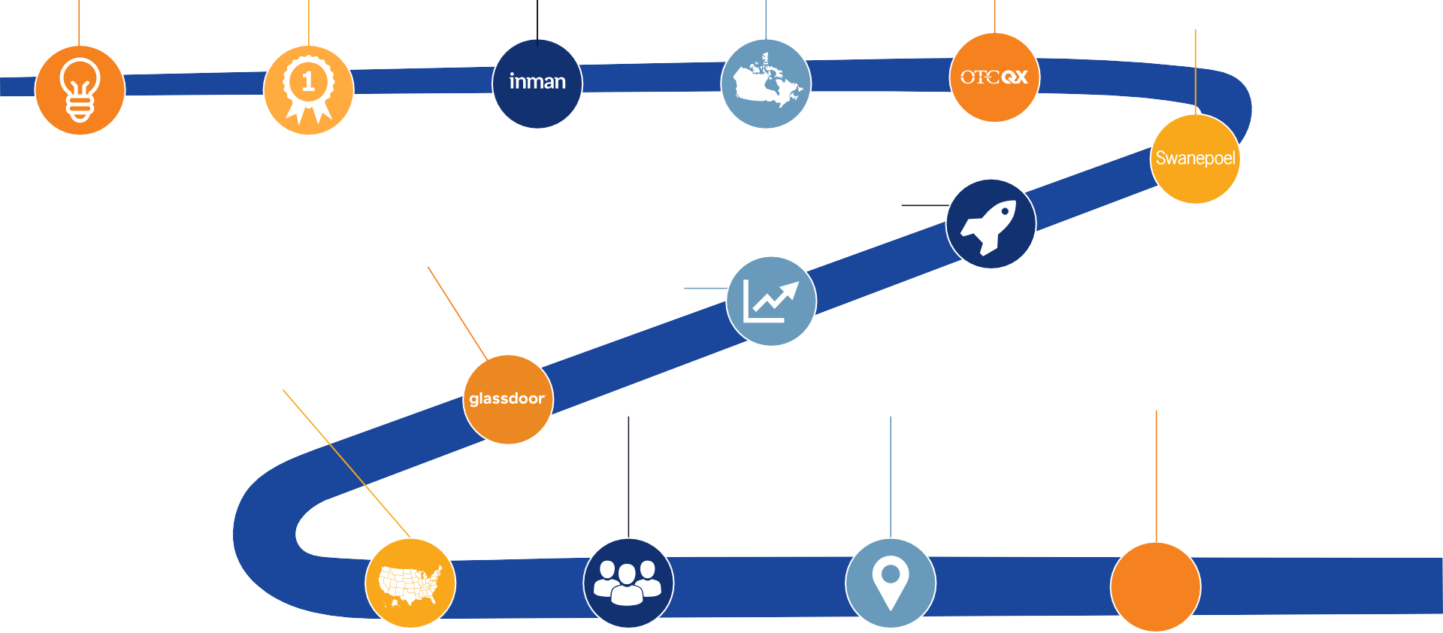


2009
eXp Realty is founded
2010
eXp celebrates 1-year anniversary, operates in 11 states
2011
eXp recognized as Innovator by Inman
2012
eXp Realty launches in Canada
2013
eXp World Holdings goes public on OTCQB exchange
2014
Founder and CEO Glenn Sanford included on 200 Most Powerful People in Real Estate by Swanepoel
2015
eXp launches Agent Equity and ICON Agent programs
2016
eXp triples agent count
in a single year
2017
eXp exceeds 6,000 agents; named to Glassdoor’s Best Places to Work list
2018
eXp World Holdings joins Nasdaq; eXp Realty open
in all 50 states
2019
eXp turns 10, now exceeds 25,000 agents; Sanford named top CEO by Glassdoor
2020
eXp Global has international footprint in 8 countries; eXp Commercial launches
2021
eXp exceeds 71,000 agents globally

Slide 6






eXp Realty Core Values
Beliefs that shape our culture
Community
Be a good neighbor to create a sustainable legacy
Service
Make positive change in our company and local community
Fun
Don’t take yourself
too seriously
Sustainability
Be a good ﬁnancial steward of the environment, the organization and our families
Agile
Force chaos and change to
survive and grow
Collaboration
We are all on the same team
Innovation
The best way to predict the future is to invent it
Transparency
Get things out from behind the curtain
Integrity
Do the right thing

Slide 7

Our Business Model

Slide 8





Innovation Is Always Happening
eXp Realty is innovating in the real estate brokerage space
Brick & Mortar Locations
Anytime, Anywhere
Traditional
real estate brokerages
*Trademarks pictured are the property of their respective owners

Slide 9


One Brokerage, Not a Franchise
eXp Realty is one international company changing the industry
Typical Franchise
Costly Overhead
Franchise and Desk Fees
Locally Conﬁned
Smaller Referral Network
Inconsistent Growth Incentives
Minimal Opportunities for Ownership
Limited Technology & Support
Few Tools and Support Resources
Powerful Equity Opportunities
Revenue Share and Stock Equity Programs
Cloud Campus Environment
No Desk Fees, Work From Anywhere
Real-time Support
Specialized Support Teams Ready to Help
Live Training
50+ Hours Weekly Online Training
International Collaboration
Expansive Referral Networks and Education

Slide 10


Agent-centric Value Proposition
eXp Realty: Most Agent-centric Company on the Planet
$
Compensation
Unique ﬁnancial model with various opportunities to make and earn income.
Community
Community means more than just a place to hang your license.
Cloud-based
Anywhere, Anytime.
The ﬁrst global brokerage to shift from
No franchise fees
Generous commissions (80/20 split with $16K cap)
Revenue-share program
for attracting agents to eXp
Equity awards for meeting production goals
Access to high-quality and affordable health insurance exclusive to eXp Agents
Cloud-based collaboration suite allows agents to connect, share and network
Company-wide diversity programs
ICON Achiever Program
Partner community with access to professional services, listing services, and client services
Mentorship programs
brick-and-mortar to cloud-based
Work from anywhere using eXp’s state-of-art technology, a virtual campus with an immersive platform connecting all agents globally
Productivity suite with collaboration tools, co-working, CRM, lead share/lead gen, referral, and over 50+ hours of weekly live education and events

Slide 11

Cloud Campus Environment
No desk fees
Work from anywhere
Cut overhead brick-and-mortar costs
No expensive leases means the company can invest in agent support and technology
Paperless transactions
Get instant access to training and support

Slide 12

Compensation
Unique ﬁnancial model with various opportunities to make and earn income.

Slide 13
No Desk Fees, Royalty Fees or Franchise Fees
Commission & Cap
80/20 commission split
$16,000 cap
After capping, earn 100% commission for the remainder of anniversary year.¹
Standard Costs (U.S.)²
$149 start-up fee
$85/month cloud brokerage fee
$25 transaction review fee ³
$40 risk management fee ⁴
Commission & Cap
● 80/20 commission split
● $16,000 cap
After that earn 100% commission for the remainder of anniversary year.¹
¹ $250 capped transaction fee. Once capped transaction fees total $5,000 then the capped transaction fee is reduced to $75.
¹ $250 capped transaction fee. Once capped transaction fees total $5,000, the capped transaction fee is reduced to $75.
² These are U.S. fees only.
³ Per transaction.
⁴ Per transaction and caps at $500.

Slide 14
Revenue Share Plan
eXp’s revenue share plan is one way that eXp rewards its agents for attracting new agents to join eXp.
Simply, an eXp agent can “sponsor” a new agent to join eXp. Once the new agent begins closing on transactions, the sponsor receives a percentage of the company revenue from the sales activity of their sponsored agent until their annual commission cap of $16,000 is reached.
Important note: eXp pays that share — not the agent. It is taken from the 20% adjusted gross commission income (AGCI) received by eXp, and is paid to the sponsor agent monthly.
To learn more, visit eXp’s eXplore Guide: https://explore.exprealty.com/.

Slide 15

Single Agent Revenue Share*
Tier 1
Up to $2,800
3.5% of the gross commission
Agents at eXp can receive revenue share income from the sales activity of agents they bring into the company.
For each person you bring into eXp you can earn up to
$2,800 depending on the sales production of that person.
This continues to be paid to you as long as you remain an active agent and the agent you have brought into the business stays with eXp and generates sales requirements.
Revenue share is paid from the percentage that eXp receives and doesn’t reduce agent commission.
*These ﬁgures are not a guarantee, representation or projection of earnings or proﬁts you can or should expect. They also do not include expenses incurred by agents in operating their businesses. eXp Realty makes no guarantee of ﬁnancial success. Success with eXp Realty results only from successful sales efforts, which require hard work, diligence, skill, persistence, competence, and leadership. Your success will depend upon how well you exercise these qualities.

Slide 16




Cascading Revenue Share
Tier 1
Up to $2,800
Tier 2
Up to $3,200
Earn more for BOTH the productive agents you bring into eXp Realty AS WELL as for the agents they bring in.
Example: If you personally sponsor 5 agents to eXp who meet the production requirements, and they in turn sponsor their own productive agents, you can earn up to an additional $3,200 annually for the production of each of those Tier 2 agents, ON TOP of the $2,800 you earn from the agents that you have brought in.
*These ﬁgures are not a guarantee, representation or projection of earnings or proﬁts you can or should expect. They also do not include expenses incurred by agents in operating their businesses. eXp Realty makes no guarantee of ﬁnancial success. Success with eXp Realty results only from successful sales efforts, which require hard work, diligence, skill, persistence, competence, and leadership. Your success will depend upon how well you exercise these qualities.

Slide 17






Revenue Share Plan Chart
eXpansion Share
% of AGCI
eXponential Share
% of AGCI
FLQA
Count Needed
Tier 1 | –– | 3.5% | 0 - 4
Tier 2 | 0.2% | 3.8% | 5 - 9
Tier 3 | 0.1% | 2.4% | 10 - 14
Tier 4 | 0.1% | 1.4% | 15 - 19
Tier 5 | 0.1% | 0.9% | 20 - 24
Tier 6 | 0.5% | 2.0% | 25 - 39
Tier 7 | 0.5% | 4.5% | 40+
AGCI = Adjusted Gross Commission Income
FLQA = Front-Line Qualifying Agent

Slide 18

Equity Opportunities
Agents can become shareholders at eXp Realty
Nasdaq: EXPI
Each year, earn shares on your ﬁrst transaction
Earn shares when you cap
Earn shares when an agent you sponsor closes their ﬁrst transaction
Sustainable Equity Plan
ICON Agent Award
Up to $16,000 in stock upon the achievement of certain production and cultural goals within your anniversary year
Agent Equity Program
Enroll to be paid 5% of every transaction commission with stock at a 10% discount

Slide 19


At eXp Realty, we’re proud to offer eXp Healthcare, which provides
U.S. eXp Realty agents and their families high-quality and affordable group health insurance.
eXp Healthcare helps agents save money, improve their provider network, and decrease their out-of-pocket costs, plus our concierge service is happy to help with all your scheduling needs.
Incredible coverage with low copays, mental health coverage and the ability to add on
According to NAR, 28-33% of Realtors® are uninsured in any given year.
Source: RISMedia, 2019
Many plans have an Open Network that allows for access to
Affordable monthly premiums, limited out-of-pocket maximum, and $0
the best doctors in the country
vision, dental, critical Illness, and accident coverage
deductible plans available
Goodbye, healthcare hassles, and hello, peace of mind.
Find the right plan for you and your family at expagenthealthcare.com

Slide 20
Cloud-Based
Brokerage whose foundation is built using innovation and cutting-edge technology.

Slide 21


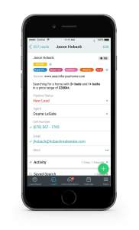

Welcome to Our World: Work Anywhere, Anytime
Join a meeting or learn on the go with eXp Realty agents everywhere.
Agents gain instant, live support from eXp’s agent services, technology and ﬁnance experts -- all from wherever an agent or team is located.

Slide 22

Cloud-based Agent Tools
The best tools and services to grow a real estate business
eXp Enterprise
Business Intelligence
Transaction Management
Community Platform
CRM & Lead Generation
Live Training
eXp’s Resource Guide

Slide 23

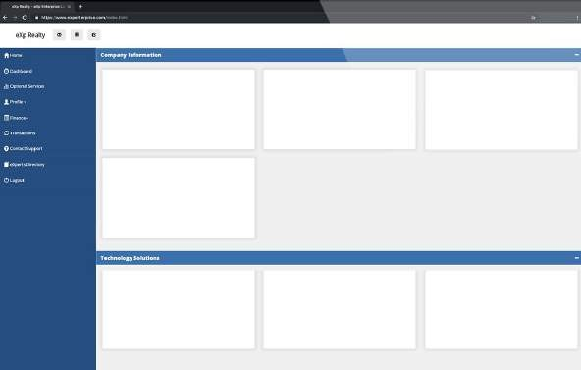




eXp Enterprise
eXp’s Enterprise dashboard gives agents autonomy and greater visibility into metrics and business intelligence that’s crucial to their needs.
exprealty.com
Investor Relations
Official Press Releases
View agent details
See commission and cap status
Review agent equity awards
Get real-time performance reports
exprealty.com
Skyslope Transaction Management
Lead generation, website, CRM
Making It Rain

Slide 24


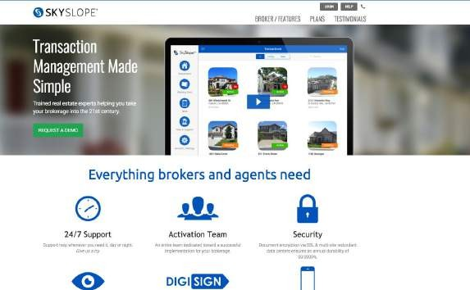
Transaction Management
eXp’s transaction management platform allows agents to manage their transactions from beginning to close — totally paperless.
Review transactions from any device
Sign documents digitally
Run your business with top-grade security features

Slide 25

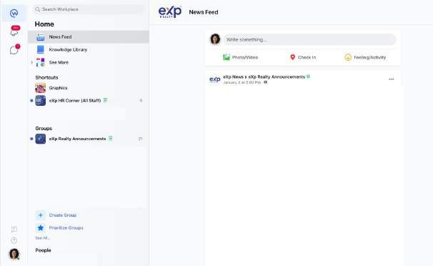

Community Platform
Workplace is an easy-to-use collaboration platform, a lot like Facebook, but built for the world of work.
Discuss topics and projects
Share announcements
Communicate instantly with your team and others across the company
Broadcast live video and view past recorded videos

Slide 26

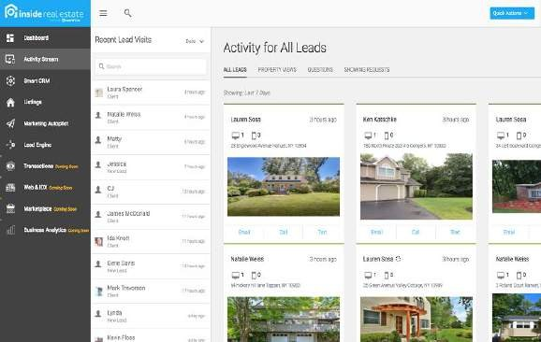
CRM & Lead Generation
Agents and teams use tools provided by eXp Realty daily to drive more leads and deals.
Manage customer interactions and share property information.
Powerful lead generation platforms provided at no additional cost
Integrate listings with your own WordPress website
Optional in-house lead generation program

Slide 27

Live Training
More than 50 hours of live training each week
Learn from industry experts and top producers about:
  Sales and listings
  Lead generation
  Social media
  CRM and technology tools
Tap into an archive of recorded sessions

Slide 28


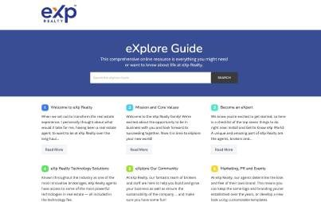

eXp’s Resource Guide & Real-Time Support
eXp’s eXplore Guide is a comprehensive online resource that covers everything you need about life at eXp Realty.
Quick, on-demand support services.
Live support from eXp Realty’s agent services, technology and ﬁnance experts.
Transaction specialists available wherever an agent or team is located.
Support teams online and available weekdays from 6 a.m. - 5 p.m. PT / 9 a.m. - 8 p.m. ET

Slide 29

Community
eXp utilizes the collective knowledge and experience of its members to create a real community based on helping each other earn, learn, grow.

Slide 30

eXp Celebrates Diversity
eXp Realty is proud of its commitment to diversity
and inclusion through its initiative, ONE eXp. This commitment supports eXp’s culture by embracing differences, promoting equality and mutual respect, and providing a space where everyone has a voice and the opportunity to succeed.
Asian Network
Black eXp Network
eXp Latino
eXp Pride Network
eXp Power Girls and more!
ONE eXp is committed to diversity and inclusion through:
Education: Host ONE eXp meetings to educate and increase awareness in this new diversity and inclusion initiative.
Coverage: Ensure diversity and inclusion is represented in marketing materials, press coverage and events.

Slide 31

eXp Life
eXp Life is eXp’s popular online news magazine where we share stories about interesting eXp agents and post the latest news about eXp World Holdings’ properties, including eXp Realty,
eXp Global, eXp Commercial,
SUCCESS Enterprises, Virbela and more.

Slide 32

International Collaboration
Interact and learn from other top professionals in the company.
Build teams across states and provinces with one nationwide cap.
Host and participate in daily, live online gatherings.
Beneﬁt from a powerful referral network.
Share best practices among peers.

Slide 33











eXp Continues International Expansion!
Australia
Brazil
Canada
France
Hong Kong
India
Italy
Mexico
Portugal
Puerto Rico
South Africa
UK
United States

Slide 34









Agent Voice in the Company
The Agent Advisory Council (AAC) is made up of nominated and selected eXp Realty agents and brokers from a variety of production levels and locations.
The AAC ensures that the voice of the agent is heard at the highest levels of the company. It beneﬁts shareholders while providing new ways for our senior leadership to obtain additional insight as our company grows.

Slide 35


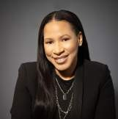


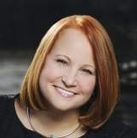



The newly selected AAC supports the continued evolution of the eXp Realty eXperience, culture and core values.
This ensures the voice of the agent is heard at the highest levels of the company.
Rebecca Hamilton
Florida
Orlando Montiel
Florida
Nakia Evans Maryland, DC, & Pennsylvania
Monica Weakley
Ohio
Jacqui Bowman
Ohio
Sylvia Dana
Michigan
Stacey Pulliam Georgia & South Carolina
Matt Ruotolo Colorado & North Carolina
Sarah Walsh
Ohio
Brian White
Texas
Jeffrey Buettner
Arizona
Alex Huffman
Minnesota

Slide 36
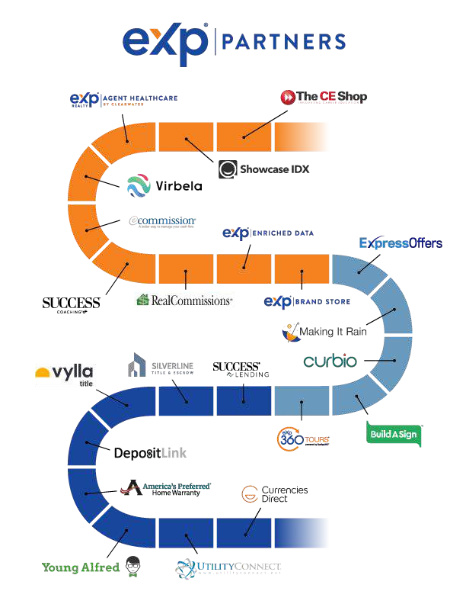
Professional solutions to enhance the professional and personal lives of eXp agents:
Agent Education: The CE Shop Wordpress IDX Plugin: Showcase IDX Agent Healthcare: eXp Agent Healthcare Virtual World: Virbela
Commission Advance: eCommission Agent Coaching: SUCCESS® Coaching Commission Advance: RealCommissions
Big Data for Commercial and Residential Real Estate: eXp Enriched Data
Oﬃcial eXp Branded Merchandise: eXp Brand Store
Listing solutions that eXp agents can use to enable and accelerate the sale of a listing: iBuyer/Cash Offers: ExpressOffers
Lead Generation Platform: Making It Rain
Pre-Sale Renovation: Curbio
Signage: Build A Sign
Photography & Virtual Tours: eXp 360 Tours
Client solutions that can better enable clients in the home buying/selling process: Residential Lending Platform: SUCCESS® Lending
Residential Title & Escrow: Silverline Title & Escrow
Commercial Title & Settlement: Vylla Title
Earnest Money Deposits: DepositLink
Home Warranty: America's Preferred Home Warranty
Home Insurance: Young Alfred Moving Services: Utility Connect Currency Exchange: Currencies Direct

Slide 37












eXp Realty’s marketplace for homebuying and selling services
Agent Healthcare
Residential Title & Escrow
Signage & Branded Collateral
Oﬃcial eXp Branded Merchandise
Agent Education
Home Insurance
Home Warranty
iBuyer Platform for Cash Offers
Commission Advance
Big Data for Commercial and Residential Real Estate
Wordpress IDX Plugin

Slide 38











eXp Realty’s marketplace for homebuying and selling services
Photography & Virtual Tours
Currency Exchange
Earnest Money Deposits
Residential Lending Platform
Commission Advance
Commercial Title & Settlement
Moving Services
Pre-Sale Renovation
Agent Coaching
Virtual World
Lead Generation Platform

Slide 39

Join the team that’s breaking down boundaries.

Slide 40






Join the Company Everyone Is Talking About
Team recruitment drives eXp’s strong agent growth in Q3.”
“eXp Realty Accelerates Its Already Signiﬁcant Growth Throughout North America.”
“The Amazon Model of Zero Physical Infrastructure: Real Estate — You’re Next.”
“The Amazon of Real Estate.”
“eXp World Holdings: Attempting To Disrupt The Real Estate Brokerage Status Quo.”
“eXp is a real estate phenomenon poised for success in 2021 and beyond.”

Slide 41


Production Matters at eXp
eXp Realty is a top-ranked, residential real estate brokerage
#1
Top Independents
Ranked by closed transaction sides for 2020
#1
Top Movers: Transactions Ranked by largest increase in closed sides from 2019 to 2020
#2
Sales Volume Increase Ranked by largest increase in percentage for closed sales volume from 2018 to 2019
#5
Transaction Sides Ranked by 2019 transaction sides
#5
Agent Count
Ranked by 2019 agent count
#2
Top Movers: Volume
Ranked by largest increase in closed sales volume from 2019 to 2020
#4
Closed Sales Volume Ranked by closed sales volume for 2020
#3
Closed Transaction Sides Ranked by closed transaction sides for 2020
#7
Sales Volume
Ranked by 2019 sales volume (ranked #13 in 2018)
#4
The Billionaires’ Club Ranked by at least $1 billion of closed sales volume in 2020

Slide 42
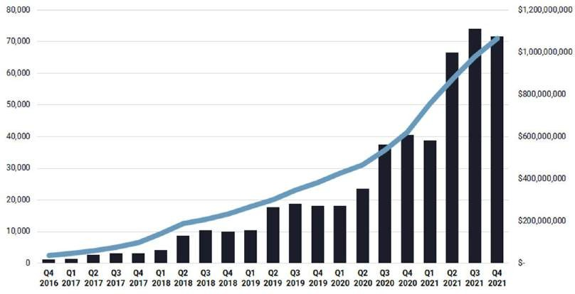


Phenomenal Agent and Revenue Growth
Elevated growth in both agent count and revenues as a result of our commitment to agents
eXp Realty Ending Agents and Revenue By Quarter
Revenues Agent Count
Agent Growth YoY 72% now 75K+ agents¹
Total 2021 Revenue $3.8B
AGENTS
REVENUES
1. Agent count as of February 23, 2022

Slide 43

My Senior Partners and I
eXp has a unique organizational structure that allows you to have access to other top leaders and producers who have sold +100 homes a year!

Slide 44


Your Name/Group (Logo)
Your Tagline
Your introduction/bio.
Who are you/your group?
What is your mission/vision?
What are your values?
What is your value proposition?
What do you have to offer?
– programs, services, trainings, etc.

Slide 45


Simone Rousseau’s Organization is a COMMUNITY of real estate agents throughout North America who work together to create power, production, and profit through a personal approach with 1-on-1 touchpoints.
Simone is recognized as an industry leader in real estate, a true Top-Producer, and an inspiration to Agents throughout North America. With exceptional discipline and determination, she consistently achieves extraordinary results for those she serves. Today, Simone’s commitment is to her Partner Agents – supporting their growth while empowering them to elevate their real estate sales and unlock their greatness!
With a Masters Degree in Education, Simone knows what it takes to lead, nurture and educate those around her from other agents to clients. Through this, Simone was able to achieve over 100 homes sold per year. Simone is now in the out of 83,000+ in eXp Realty and is in the Top 10 overall in Canada. Top 150 agents
Simone has also completed 7 marathons so if you are looking for someone to run with, she can help lead you to success!
The
Organization
TOP FEMALE AGENT ATTRACTOR IN eXp Canada.

Slide 46

Opportunities & Resources
Other services offered by Simone Rousseau
- Exclusive access to the VIP Room
(Library, Support, Events)
- 1-on-1 Mega Attraction Coaching with Simone
- Access to the Mega Attraction Bootcamp E-course
- Monthly Agent Attraction 101 Training
- Live Weekly Agent Upgrade Production Training & On-Demand Recordings and Downloads
- Onboarding Concierge for New Agents
- Marketing & Branding Support
- Business Strategy & Development Coaching

Slide 47
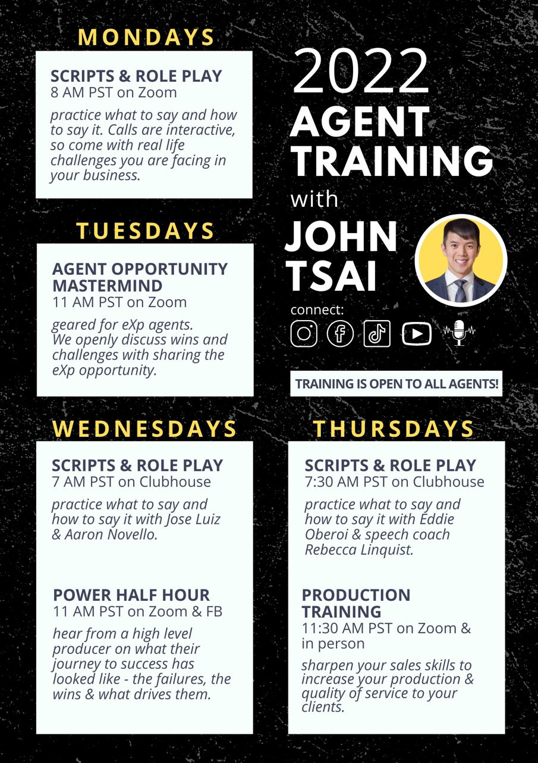
John Tsai
16+ YEARS OF EXPERIENCE. 132 HOMES SOLD IN 2020.
John Tsai has received numerous accolades, including the Master Medallion Club Award (2010-2021), President’s Club Award (2015-2018), and eXp Realty's 4X ICON Agent Award (2019-2022). Reading Rich Dad, Poor Dad lead him to launch his real estate career in 2006. Day by day, John puts his clients first, endeavouring to find home buyers their dream home and to provide home sellers the highest possible return on their investment.
His goals for the future include building a team that manages 400 transactions a year, creating a rental-property portfolio, and giving back by through charitable contribution and by inspiring other Realtors. It’s no surprise that John grew up dreaming about building high rises.
John’s guilty pleasures are his daily visits to Facebook and Instagram—“It’s an addiction,” he says—and he cites Terminator as the movie that’s most inspired him, because “he’s indestructible. He just keeps coming back until he’s achieved his goal.”
Another note: John is also currently in the Top 1% and ranked the Number 10 Realtor in the Greater Vancouver area out of 15,000 agents.

Slide 48

Become an eXp Agent
Talk to your sponsor, or apply today at join.exprealty.com

